Slide 1

Sentiment Analysis
A Summer Internship Report submitted in partial fulfilment of the requirements for the award of degree of
BACHELOR OF TECHNOLOGY
In
CSE (Artificial Intelligence
and machine learning)
Submitted by:
B. KUMAR RAJ
22MH1A42E4
Department Of CSE (Artificial Intelligence and machine learning)
ADITYA COLLEGE OF ENGINEERING & TECHNOOGY
Approved by AICTE, Permanently affiliated to JNTUK & Accredited by NAAC with ‘A’ Grade Recognized by UGC under the sections 2(f) and 12(B)of the UGC act 1956 Aditya Nagar, ADB Road –Surampalem 533437, E.G. Dist., A.P., 2022-2023

Slide 2

Problem Statement
1
Identifying Sentiment
2
Contextual Understanding
3
Real-Time Applications
Accurately determine the emotional tone and attitude expressed in textual data.
Interpret the nuanced meaning behind language by considering the context and subjectivity.
Deploy sentiment analysis in dynamic, fast-paced environments to drive timely decision-making.

Slide 3

Sentiment Analysis: Unraveling the Emotions Behind Text
Explore the power of sentiment analysis in understanding the emotional undercurrents embedded within text data. Dive into the process of extracting, classifying, and interpreting subjective information to unlock valuable insights.

Slide 4
Dataset Overview
Data Sources
Labeling Approach
Data Diversity
Curate a comprehensive dataset from online reviews, social media, forums, and other relevant textual sources.
Utilize a combination of human annotations and automated techniques to categorize the sentiment of each text sample.
Ensure the dataset encompasses a wide range of topics, industries, and user demographics to enhance model performance.

Slide 5
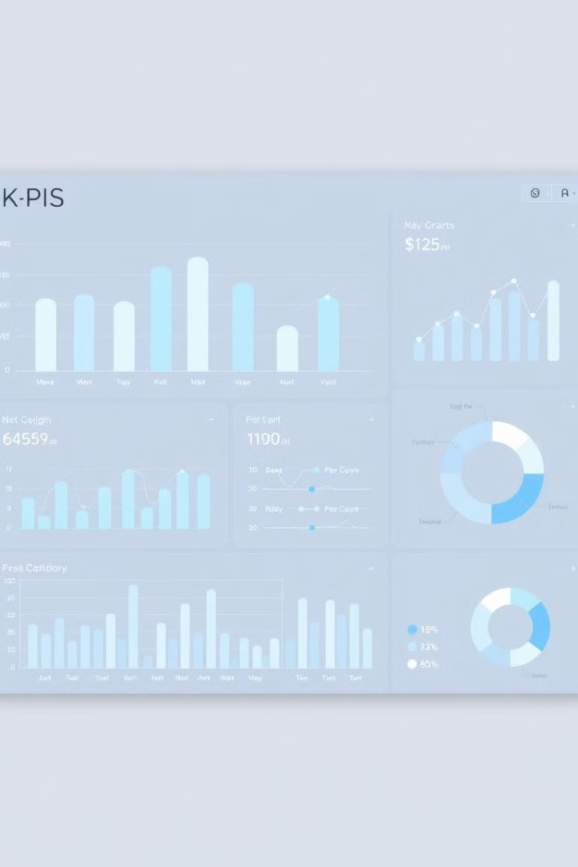
Exploratory Data Analysis
1
Sentiment Distribution
Analyze the overall sentiment balance within the dataset, identifying the prevalence of positive, negative, and neutral sentiments.
2
Linguistic Patterns
Uncover common phrases, keywords, and language structures that correlate with specific sentiment polarities.
3
Contextual Insights
Explore the relationships between sentiment, user demographics, and topic domains to gain a deeper understanding of the data.

Slide 6

Data Preprocessing
Text Cleaning
Tokenization
Remove noise, handle misspellings, and standardize the input text to prepare it for further analysis.
Break down the text into individual words or phrases to enable feature extraction and model training.
Stop Word Removal
Lemmatization
Eliminate common, uninformative words that do not contribute to sentiment detection.
Convert words to their base forms to improve the model's understanding of linguistic variations.

Slide 7





Feature Engineering
Lexical Features
Syntactic Features
Leverage word-level attributes, such as sentiment scores, part-of-speech tags, and word embeddings.
Analyze sentence structure, grammar, and the relationships between words to capture contextual nuances.
Emotion-Based Features
Statistical Features
Incorporate emotion-specific dictionaries and models to quantify the emotional intensity within the text.
Extract descriptive statistics, such as word counts, sentiment polarity scores, and readability metrics.

Slide 8




Model Selection
Logistic Regression
Efficient and interpretable model for binary sentiment classification tasks.
Support Vector Machines
Robust and versatile algorithm that can handle complex, high-dimensional feature spaces.
Neural Networks
Powerful deep learning models that can capture intricate patterns in text data.

Slide 9

Model Training
1
Data Partitioning
Split the dataset into training, validation, and test sets to ensure unbiased model evaluation.
2
Hyperparameter Tuning
Optimize model parameters, such as learning rate, regularization, and architecture, to improve performance.
3
Convergence Criteria
Monitor training and validation metrics to determine when the model has reached optimal performance.

Slide 10
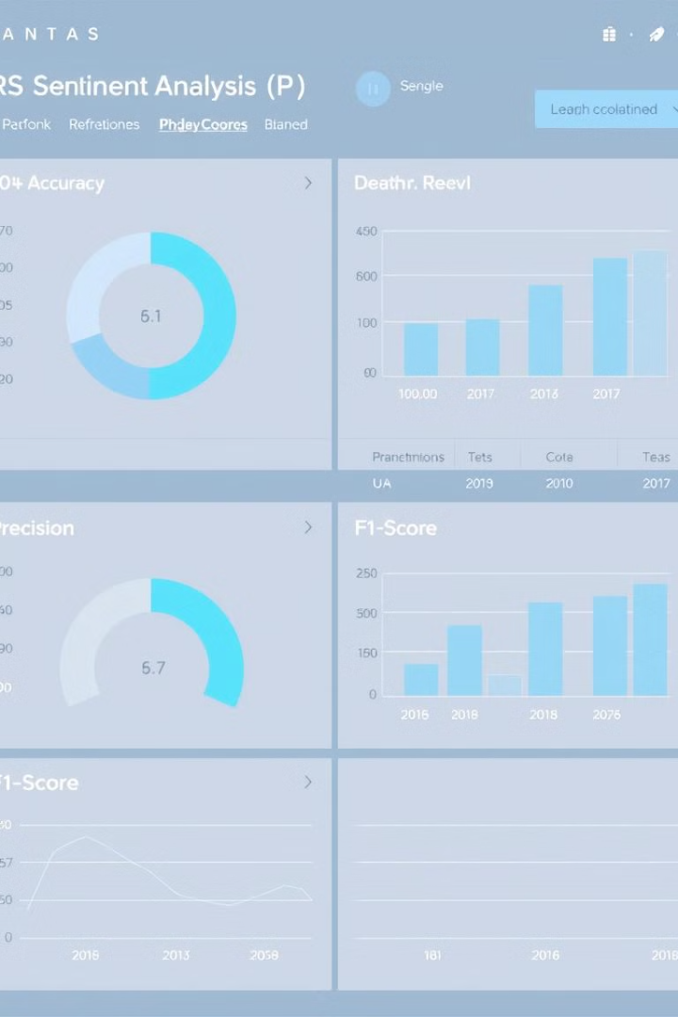
Model Evaluation
Metric
Description
Value
Accuracy
Overall correctness of the model's predictions
87%
Precision
Proportion of true positives among all positive predictions
91%
Recall
Proportion of true positives among all actual positive instances
84%
F1-Score
Harmonic mean of precision and recall
88%

Slide 11

Challenges and Future Directions
Contextual Ambiguity
Domain Adaptation
Addressing the nuanced interpretation of sentiment in different cultural and linguistic contexts.
Developing techniques to adapt the sentiment analysis model to specific industries or applications.
Multimodal Integration
Ethical Considerations
Incorporating visual, audio, and other modalities to enhance sentiment analysis beyond text-only data.
Ensuring the responsible use of sentiment analysis, respecting privacy and avoiding biases.

Slide 12
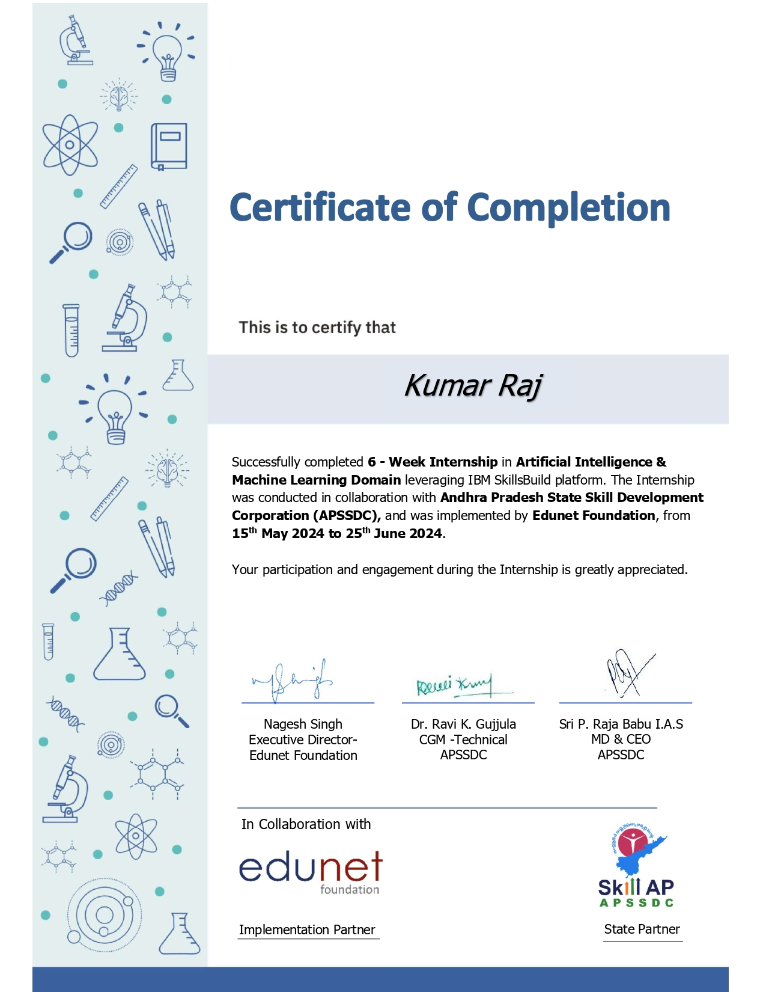



Completion certificate

Slide 13
Thank you

